Slide 1
2026.03.05 일일 보고 학습 내용 정리
공민수 석사과정생

Slide 2
목차
Pole Placement PI & DOB
Tracking Performance with Bode plot
Disturbance Estimation Performance
Adding Feed Forward Control
Change of Control Input & Tracking Performance
Adding the nominal values of maxon motor
Effect of Saturation

Slide 3
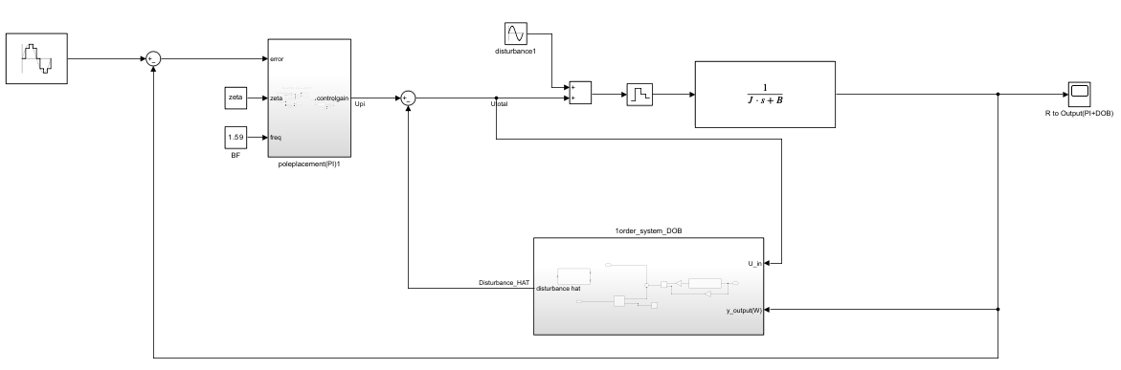
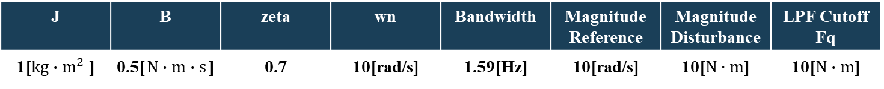
Pole Placement PI & DOB 구현
Velocity Control Block Diagram with PI & DOB
Arbitrary Constant Parameters
Varying Parameters
Frequency of Reference
Frequency of Disturbance
J | B | zeta | wn | Bandwidth | Magnitude Reference | Magnitude Disturbance | LPF Cutoff Fq
1[$kg∙m^{2}$ ] | 0.5[$N∙m∙s$] | 0.7 | 10[rad/s] | 1.59[Hz] | 10[rad/s] | 10[$N∙m$] | 10[$N∙m$]

Slide 4
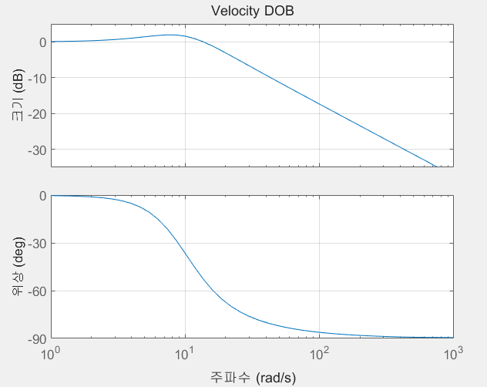
Tracking Performance with Bode plot
Approach
Relationship between Reference frequency and PI Bandwidth
Analysis Method
Tracking Performance Observation by Adjusting Input Frequency Based on Bode Plot Gain and Phase
Gain = 1.1995
Magnitude = 1.58 [dB]
Phase = -36.57 [deg]
Wn

Slide 5
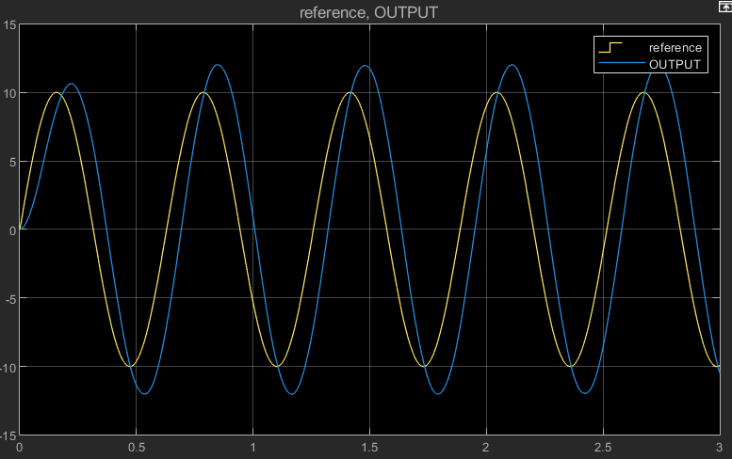
Tracking Performance with Bode plot
Results
Frequency of reference = Bandwidth
Ref
Output
Output Peak = 12.02 [rad/s]
Reference peak = 10 [rad/s]
Gain = 1.202
W[rad/s]
Time [s]
Phase Delay = 0.061 [s]
Frequency= 1.59 [Hz]
Phase = 34.91 [deg]
W[rad/s]
Time [s]

Slide 6
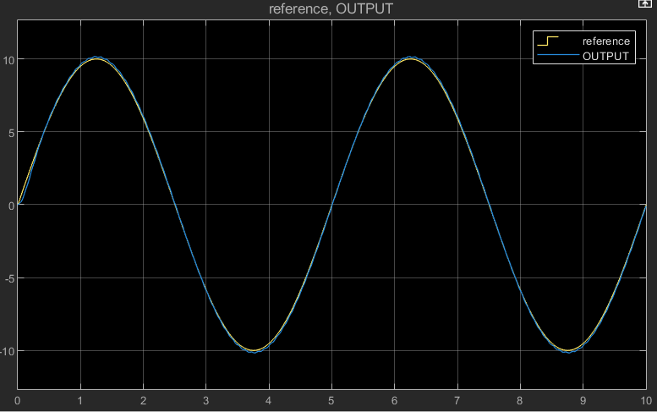
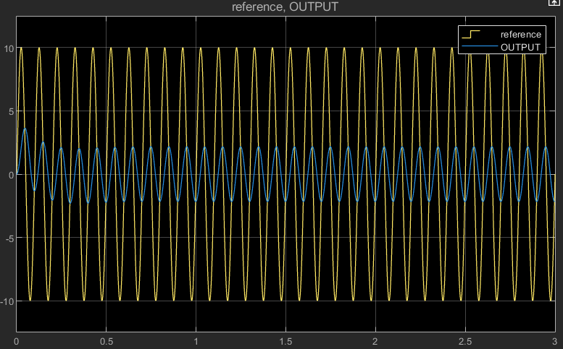
Tracking Performance with Bode plot
Results
Frequency of reference << Bandwidth
Frequency of reference > >Bandwidth
W[rad/s]
W[rad/s]
Time [s]
Time [s]
Ref
Output
Conclusions
The bandwidth in pole placement can be used to tune the frequency range for tracking.

Slide 7
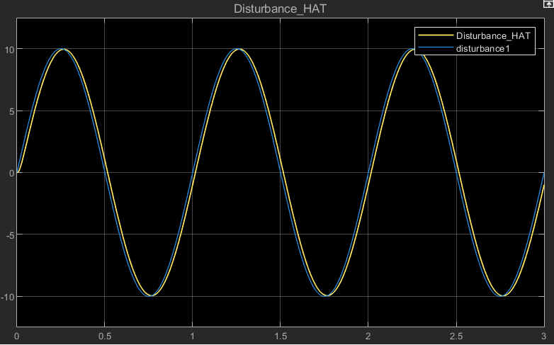
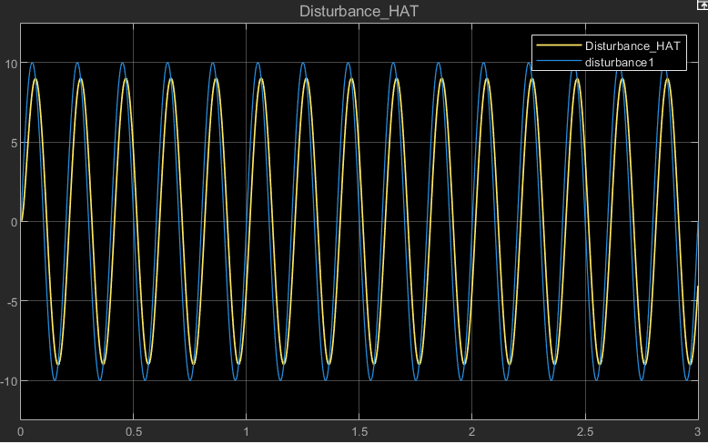
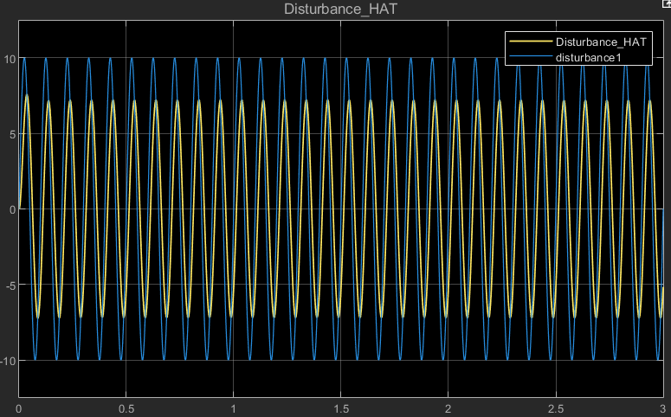
Disturbance Estimation Performance
Approach
Relationship between Reference frequency and PI Bandwidth
Analysis Method
Estimation Performance by Adjusting Disturbance Frequency Based on 1st LPF
Results
Conclusion
The Disturbance estimation performance is influenced by the cutoff frequency of the LPF
D_hat
D
W[rad/s]
1[Hz]
5[Hz]
10[Hz]
Time [s]

Slide 8
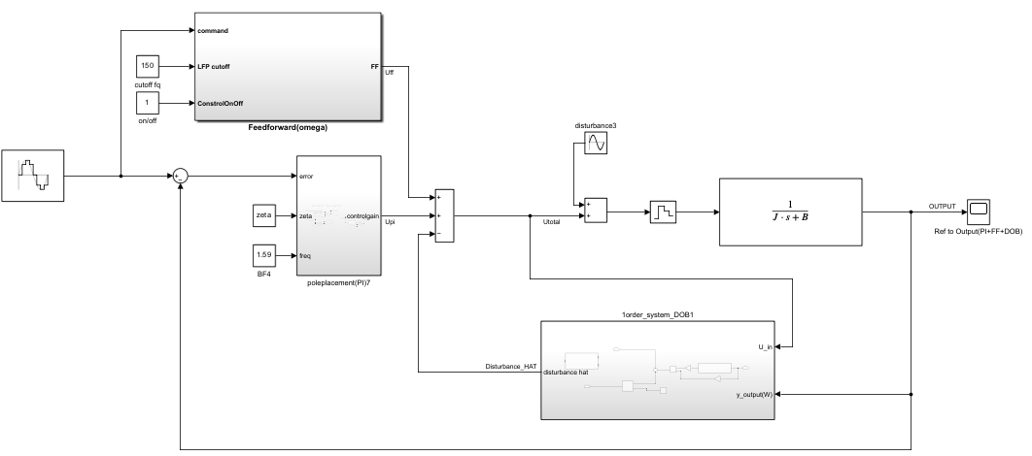
Adding Feed Forward Control
Velocity Control Block Diagram with PI, DOB & Feed Forward
Parameters is the Same with ‘Velocity output with PI & DOB’ and Feed Forward Cutoff Frquency is 150 [Hz]

Slide 9
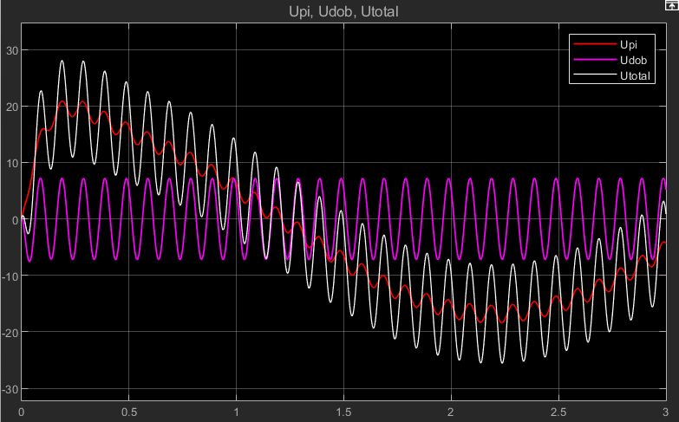
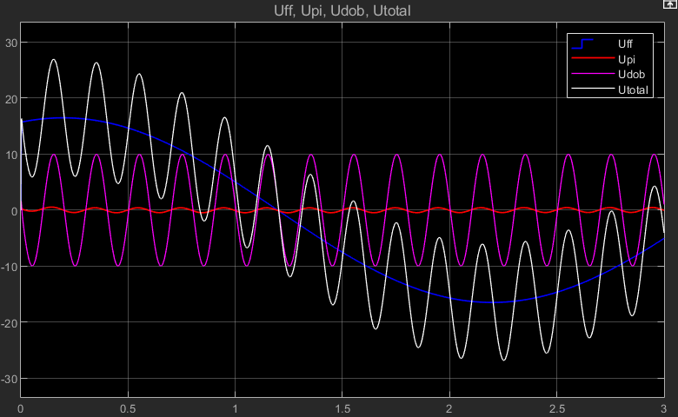
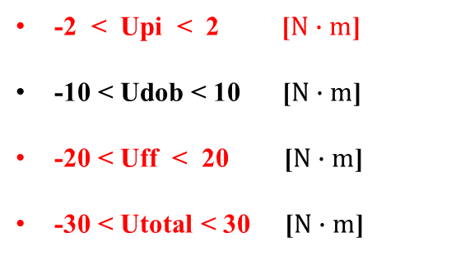

Change of Control Input & Tracking Performance
Change of Control Input Upi, Udob, Uff respectively
Upi & Udob
Upi & Udob & Uff
Upi
Udob
-20 < Upi < 20 [$N∙m$]
-10 < Udob < 10 [$N∙m$]
-30 < Utotal < 30 [$N∙m$]
T[Nm]
Time [s]
Uff
-2 < Upi < 2 [$N∙m$]
-10 < Udob < 10 [$N∙m$]
-20 < Uff < 20 [$N∙m$]
-30 < Utotal < 30 [$N∙m$]
T[Nm]
Time [s]

Slide 10
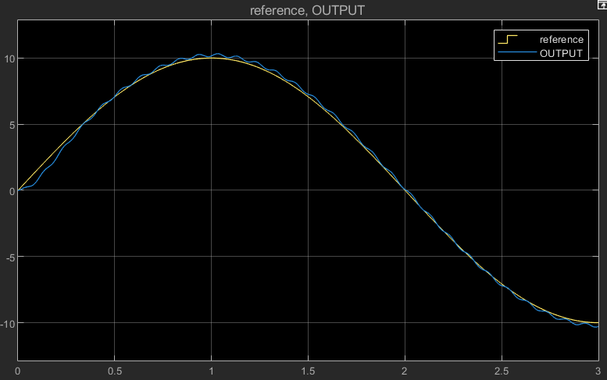
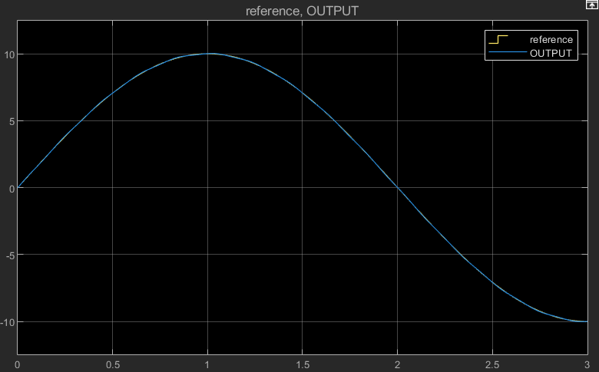
Change of Control Input & Tracking Performance
Change of the Tracking Performance
Upi & Udob
Upi & Udob & Uff
Ref
Output
Phase lag and Tracking Error
W[rad/s]
Time [s]
Ref
Output
Good Error and response performance
W[rad/s]
Time [s]

Slide 11
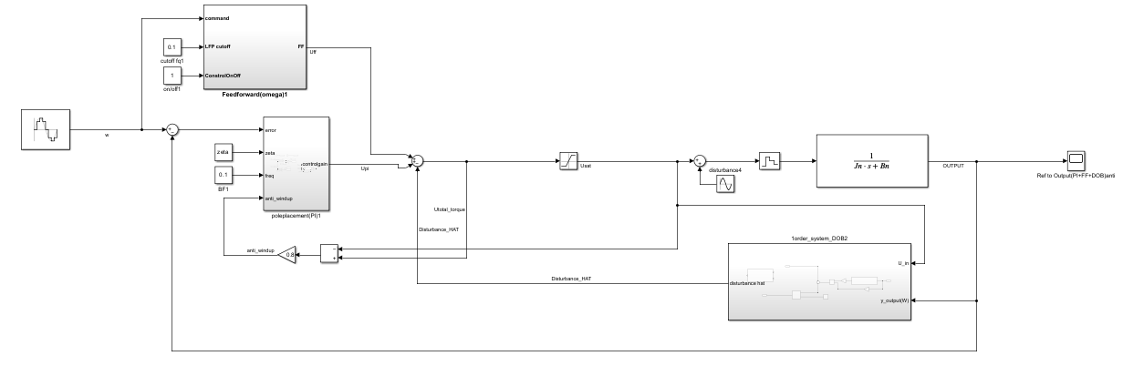
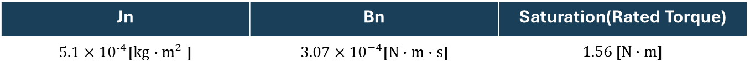
Adding the nominal values of maxon motor
Velocity Control Block Diagram with PI, DOB & Feed Forward (Maxon motor)
Nominal Parameters
Jn | Bn | Saturation(Rated Torque)
${5.1×10}^{-4}$[$kg∙m^{2}$ ] | ${3.07×10}^{−4}$[$N∙m∙s$] | $1.56$ [$N∙m$]

Slide 12
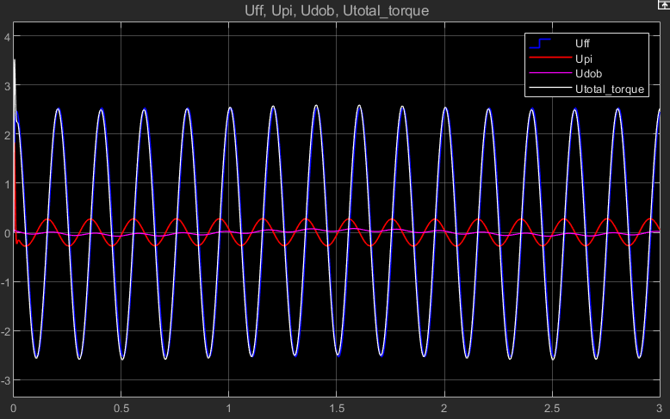
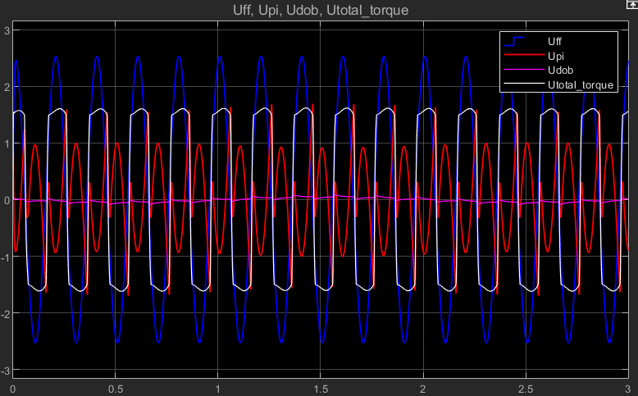
Effect of Saturation
Change of Control input
Ideal Case
Saturation Case
T[Nm]
T[Nm]
Time [s]
Time [s]
Uff
Upi
Udob
Analysis
Saturation case’s Upi is bigger than Ideal Case
Saturation case’s Udob becomes irregular than Ideal Case

Slide 13
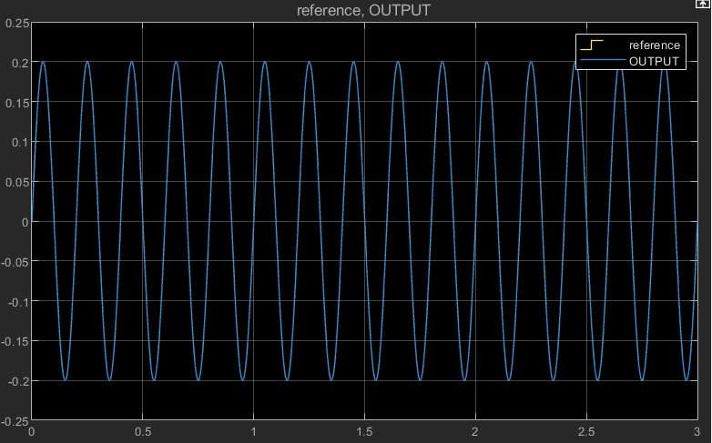
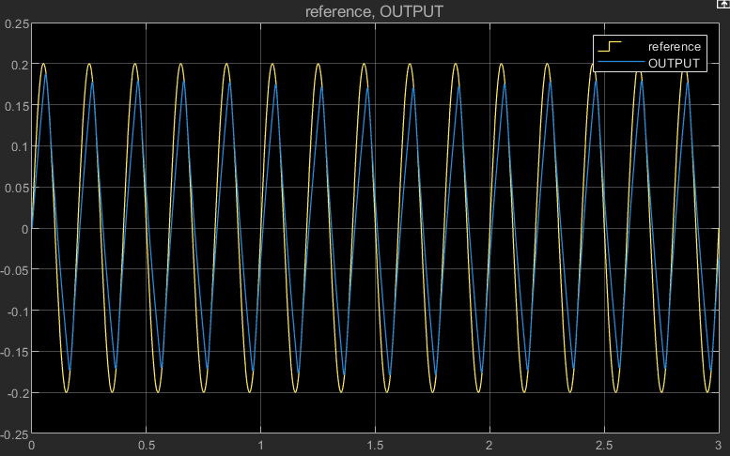

Effect of Saturation
Reference Tracking Performance
Ideal Case
Saturation Case
W[rad/s]
W[rad/s]
Time [s]
Time [s]
Ref
Output
Analysis
Phase Lag, Magnitude Decrease
Conclusion
Actuator saturation leads to error accumulation, which increases the integrator output $U_{pi}$and degrades the tracking performance.

Slide 14
TO DO
Rover wheel을 통해 시뮬레이션으로 학습했던 내용들을 실습해본다.
특히 입력 주파수 대역과 Bandwidth, Cutoff Frequency를 고려하며 tracking튜닝을 진행한다.

